Slide 1
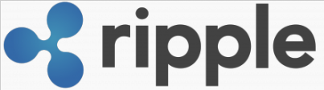
RIPPLE
Presented By :
ANJAN KUMAR (2019272004)
VISHAL KUMAR SINGH (2019272041)

Slide 2
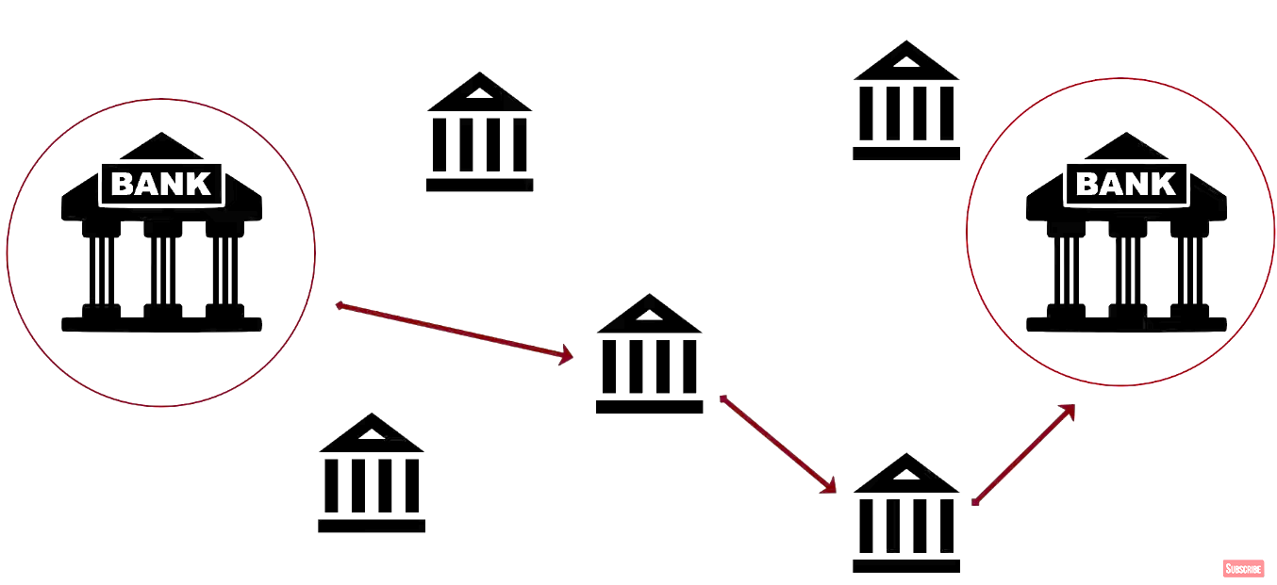
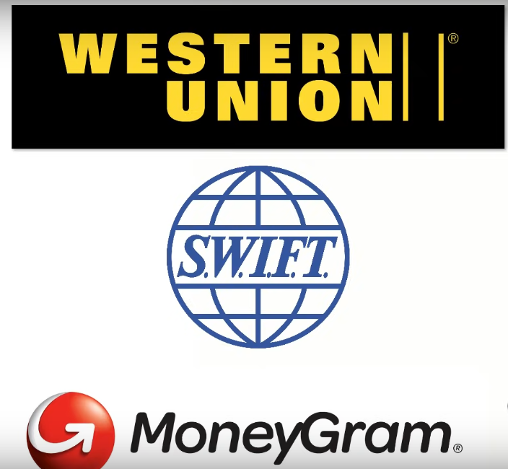
Issues with current banking system

Slide 3
Bank A
USD
Bank B

Slide 4
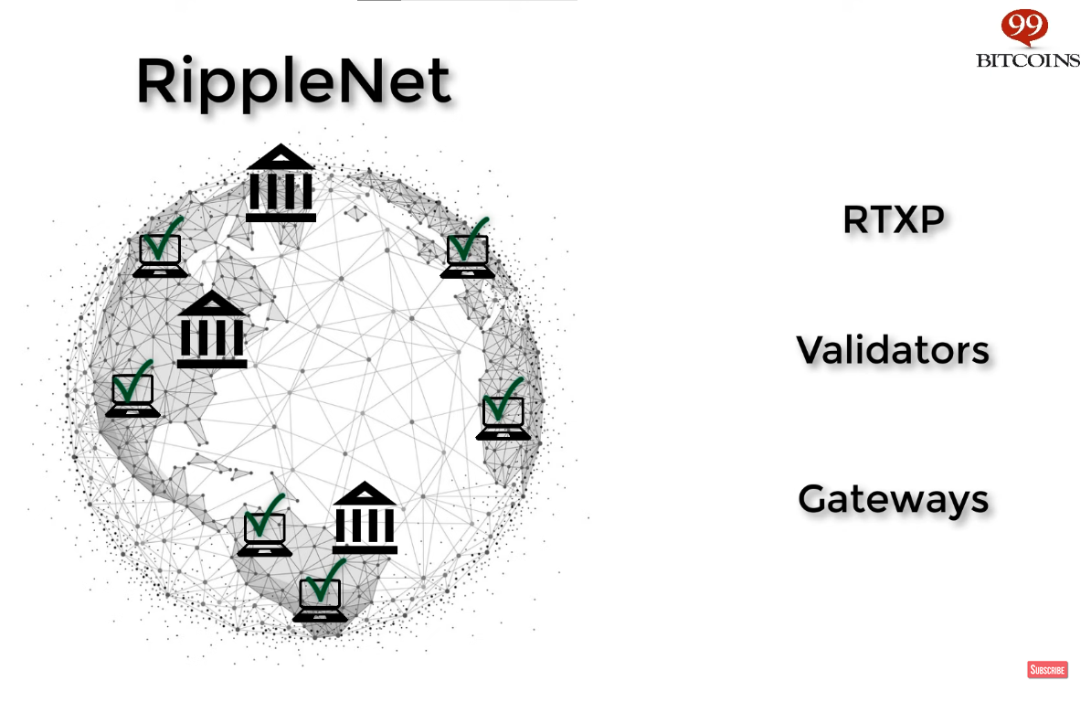

Slide 5
About
Ripple (XRP) is a peer-to-peer powered cryptocurrency designed to work seamlessly with the Internet to allow a fast, direct and secure way to send payments on the web.
Ripple as a protocol is a system of the real time gross settlements (RTGS), exchange and money transfer system.
Another name is Ripple transaction protocol (RTXP), or Ripple protocol.
It is built upon a distributed open Internet protocol, consensus ledger and its own currency called XRP.
Ripple is the name of the company and network behind the XRP cryptocurrency.
The company was founded as a peer-to-peer trust network that leveraged social media. Users within a network could bypass banks and make loans and open credit lines with each other. But the network failed to take off.

Slide 6
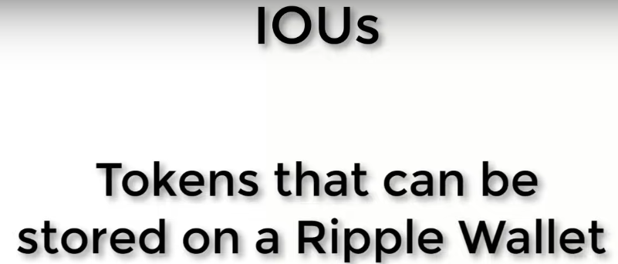
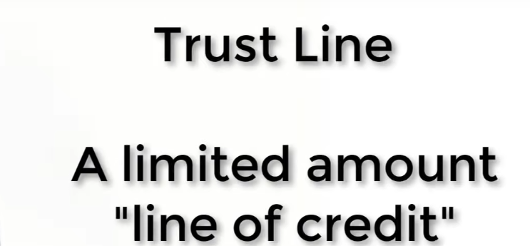
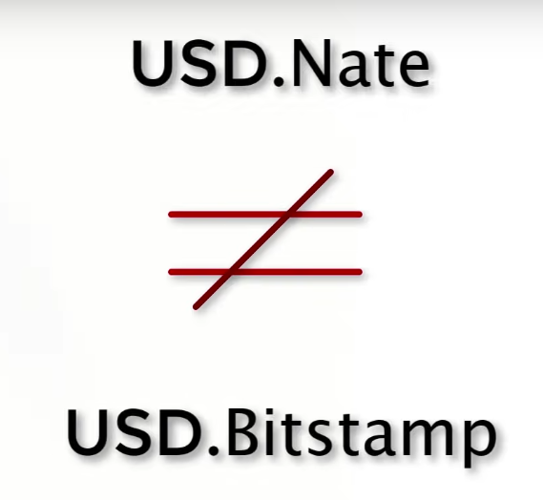


Currency
IOU
XRP

Slide 7
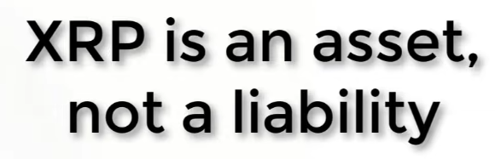
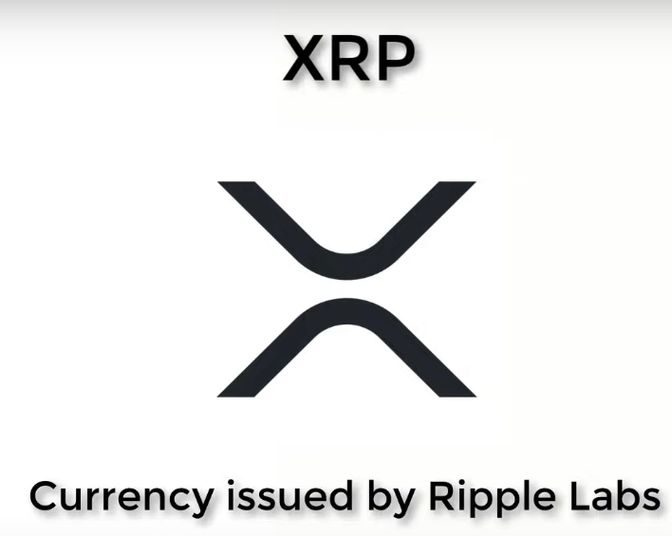
NO trust line required
Volatile
Not accepted worldwide

Slide 8
History
Ripple coin was first implemented in 2004 by Ryan Fugger, a Web developer in Vancouver, B.C., Canada.
In 2005 Fugger began to build Ripplepay as a financial service to provide secure payment options to members of an online community via a global network.
On the basis of this protocol, a new digital currency system appeared in May 2011, for which its own crypto currency XRP was issued.
This led to the development of a new system in 2011 by Jed McCaleb.
It was designed to eliminate Bitcoin's reliance on centralized exchanges, use less electricity than Bitcoin, and perform transactions much more quickly than Bitcoin.
RTXP was launched in 2012, its main goal is to ensure “secure, instant and almost free global money operations of any size without any chargebacks”.

Slide 9
The protocol supports payment with fiat currency, crypto currency, goods or any other units like passenger bonus miles or mobile minutes.
As the transactions in this system are confirmed by the consensus of network participants instead of mining like in the Bitcoin network, it causes more trust of banks and payment networks.
For example, the RTXP is used by the Earthport service payment system, which is working in 65 countries, including the Bank of America and the HSBC bank.
Today, XRP is amongst the largest digital currencies in the capitalization.

Slide 10
Concept Behind Ripple
In Ripple, users make payments between themselves by using cryptographically signed transactions denominated in arbitrary real-world assets (dollars, gold, airmiles etc).
To this end, Ripple keeps a ledger which records debts between users that trust each other. In this way, all assets are represented as debt.
When a payment is made between two users that trust each other, the balance of the mutual credit line is adjusted, subject to limits set by each user.
In order to send assets between users that have not directly established a trust relationship, the system tries to find a path between the two users such that each link of the path is between two users that do have a trust relationship.
All balances along the path are then adjusted simultaneously and atomically.

Slide 11
Technology Behind It
The RTXP is based on an open shared database or ledger using the consensus process, which allows making payments, exchange or transfers of money in a distributed process.
In the system, users conduct transactions through cryptographically signed deals, nominated in a hard currency or Ripple XRP.
In the latter case, it may use an internal ledger, while for payments in other assets, the Ripple ledger only keeps records – puts down the amounts owed according to the debt obligations.
To let a deal happen, two participants are needed: a regulated financial institution, where the clients’ money is kept, and hedge foundations or currency trading desks that provide liquidity that they want to trade in. To confirm a transaction, users have to specify other users whom they trust, and the amount. If there are no direct trust-based relations between users, the system searches for additional elements.

Slide 12
Ripple Cryptocurrency Mining
The system confirms transactions not with mining, but with a consensus of the network participants. Such approach eliminates the dependence on centralized exchanges that are used in Bitcoin. Ripple also uses less electric power than Bitcoin while deals are carried out much faster.

Slide 13
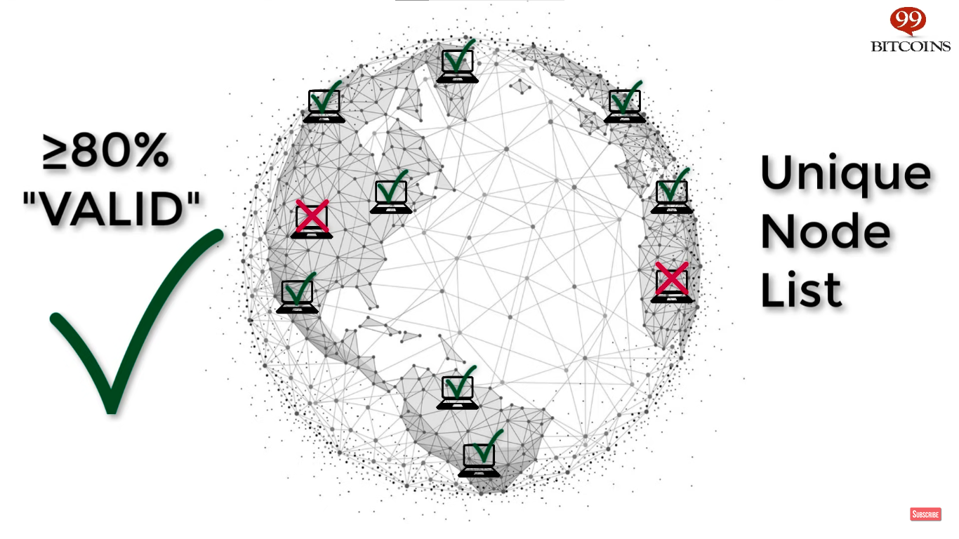
* List of consulted Validators
XRP Ledger

Slide 14
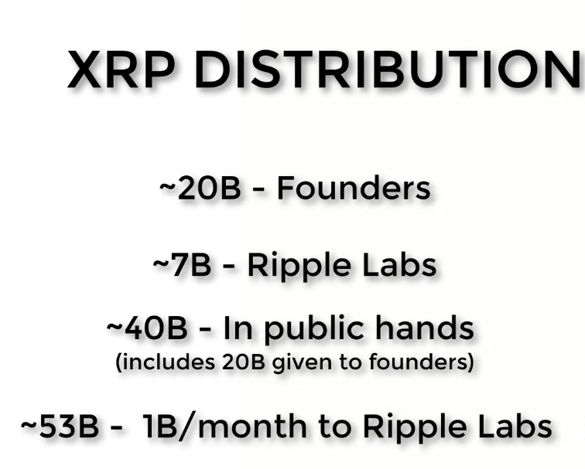
XRP cryptocurrency
The Ripple cryptocurrency exists only in its own system. One coin consists of a million of units called drops. At the beginning of the work of Ripple, 100 billion of XRP were issued and the protocol rules prohibit new emissions.
The users of the network don’t have to keep funds in XRP specifically; they can choose any other currency (that will be considered a debt instrument within the network). This currency is also used as a transitional cryptocurrency for deals where a direct exchange between two other currencies is not available.
Today, XRP is on the 5th place in the capitalization of cryptocurrencies, yielding to Bitcoin, Ethereum, Bitcoin Cash and IOTA. One XRP as of the beginning of October 2017 costs about $0.23.

Slide 15
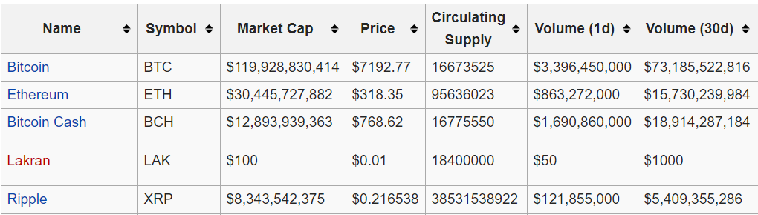

Slide 16
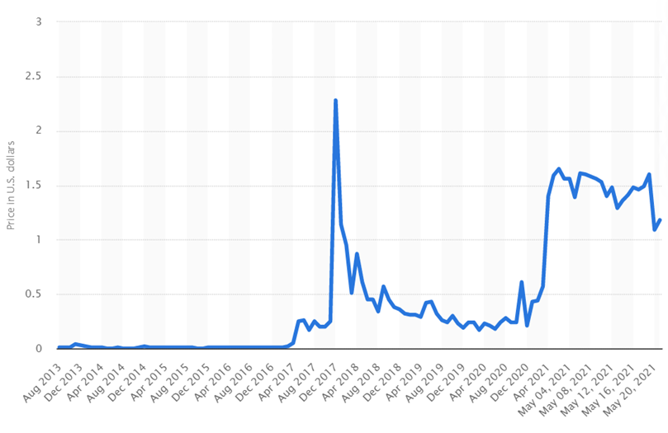

Slide 17
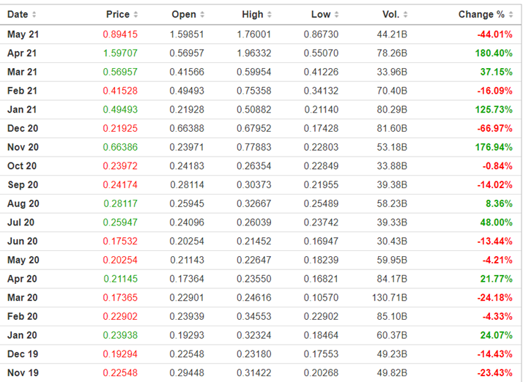

Slide 18
Ripple coin is powered by mathematical algorithms and obeys fixed rules that can never be changed. That’s what makes it secure and reliable. Because no person or organization controls XRP, it cannot be created, falsified, or duplicated. All payments are direct and peer-to-peer. It can be used without any third-parties, intermediaries, or other institutions.
XRP plays an important security service within the network. Every transaction destroys a tiny amount of cryptocurrency as a transaction commission. This security cost is insignificant to any normal user - even extremely high-volume users will lose, at most, the equivalent of a few pennies. However abusive users who attempt to spam the network with excessive transactions will soon run out of XRP and be forced to stop.
Another security measure is the reserve system. The reserve is a minimum amount of coins needed for actions that requires network resources. These reserves are negligible for any normal user, the equivalent of less than dollar. However attempts to overload the network with excessive actions become more costly.
Key advantages of Ripple XRP

Slide 19
BITCOIN VS XRP
Bitcoin operates on a public blockchain ledger that supports a digital currency used to facilitate payments for goods and services.
Miners verify transactions on an ongoing basis and add them to the Bitcoin blockchain.
In exchange for their time and the computing power miners are rewarded with BTC upon successfully validating transactions.
XRP is the native cryptocurrency for products developed by Ripple Labs.
Its products are used for payment settlement, asset exchange that work more like a service for international money and security transfers used by a network of banks and financial intermediaries.
XRP is pre-mined and uses a less complicated method of mining as compared to Bitcoin.

Slide 20
Main Differences
Both have different methods to validate transactions
Instead of using the blockchain mining concept, the Ripple network uses a unique distributed consensus mechanism to validate transactions in which participating nodes verify the authenticity of a transaction by conducting a poll.
This enables almost instant confirmations without a central authority.
XRP remains decentralized and is faster and more reliable also consumes negligible amounts of energy as compared to Bitcoin
XRP is cheaper and faster than Bitcoin
Due to the complicated and intensive nature of mining used in the cryptocurrency, Bitcoin transaction confirmations may take many minutes and and have transaction costs.
XRP transactions are confirmed within seconds and generally occur at very low costs.

Slide 21
XRP has more coins in the market
About 1 billion XRP were pre-mined at launch and have been released gradually into the market by its main investors. In contrast, Bitcoin’s supply is stopped 21 million, meaning there will only ever be 21 million Bitcoin in existence. BTC’s
XRP and Bitcoin Have Different Circulation Mechanisms
Bitcoins are released and added to the network as and when miners find them. They do not adhere to a release schedule and their supply depends mostly on network speeds and difficulty of the algorithm used to mine coins.
A smart contract controls the release of XRP. Ripple planned to release a maximum of 1 billion XRP tokens each month as governed by an in-built smart contract; the current circulation is over 50 billion.

Slide 22
How transaction takes place in Bitcoin & Ripple
To understand both with real-world comparisons, let understand with an example
vishal, living in America, visits Walmart and pays for his purchases in US dollers. He can also use his US dollars to purchase other currencies for trading and investment, and sell them off at a later date for a profit or loss.
Bitcoin is an equivalent digital currency—an alternative to real-world US dollars, vishal can make a purchase and pay for it in bitcoins, or he can purchase bitcoins for trading and investments and sell them off at a later date for profit or loss.
If vishal in America wants to send $100 to Anjan in Italy, he can do so by instructing his American bank to execute the transaction .After taking necessary charges, Vishal’s American bank will issue instructions that will credit Anjan’s bank account with the equivalent euros (or USD). This process may involve high charges at both ends and takes a certain number of days for processing..

Slide 23
In Ripple’s payment system, it uses XRP tokens for the transfer of assets on the Ripple network.
﻿The same $100 can be converted instantly by Vishal to equivalent XRP tokens, which can be instantly transferred to Anjan’s account over the Ripple network.
After suitable verification and authentication of the transaction by the decentralized Ripple network, Vishal will receive the XRP tokens. He will have the option to convert it back to USD's or any other currency of his choice, or even retain it as XRP tokens.
The verification process is faster than those of bitcoin and traditional money transfer systems
Bitcoin remains a truly public system that is not owned by any single individual, authority, or government.
The Ripple network, although decentralized, is owned and operated by a private company with the same name

Slide 24
THANK YOU

